Slide 1
Lecture 13-15
Database Design and the E-R Model

Slide 2
Outline
Design Phases
Design Approaches
ER Model

Slide 3
Design Phases
The initial phase of database design is to characterize fully the data needs of the prospective database users. (requirements of system)
Next, the designer chooses a data model and, by applying the concepts of the chosen data model, translates these requirements into a conceptual schema of the database.
A fully developed conceptual schema also indicates the functional requirements of the enterprise. In a “specification of functional requirements”, users describe the kinds of operations (or transactions) that will be performed on the data.
Notes:
3
Underlying the structure of a database is the data model. A data model provides a way to describe the design of a database at the physical, logical, and view levels.
A high-level data model provides the database designer with a conceptual framework in which to specify the data requirements of the database users, and how the database will be structured to fulfill these requirements. The outcome of this phase is a specification of user requirements.
Next, the designer chooses a data model, and by applying the concepts of the chosen data model, translates these requirements into a conceptual schema of the database. The schema developed at this conceptual-design phase provides a detailed overview of the enterprise. At this stage of conceptual design, the designer can review the schema to ensure it meets functional requirements.

Slide 4
Design Phases (Cont.)
The process of moving from an abstract data model to the implementation of the database proceeds in two final design phases.
Logical Design – Deciding on the database schema.
Business decision (What) – What attributes should we record in the database?
Computer Science decision (Why) – What relation schemas should we have and how should the attributes be distributed among the various relation schemas?
Physical Design – Deciding on the physical layout of the database
Notes:
4
The process of moving from an abstract data model to the implementation of the database proceeds in two final design phases.
In the logical-design phase, the designer maps the high-level conceptual schema onto the implementation data model of the database system that will be used. The designer uses the resulting system-specific database schema in the subsequent physical-design phase, in which the physical features of the database are specified. These features include the form of file organization and the internal storage structures.

Slide 5
Design Approaches
Entity Relationship Model (top down approach)
Models an enterprise as a collection of entities and relationships
Represented diagrammatically by an entity-relationship diagram:
Normalization Theory (bottom up approach)
Formalize what designs are bad, and test for them
Notes:
5
Different types of data Model have been discussed (object oriented, record based, network) in previous lecture, here we will use ER Model for designing the Database. There are different notation for designing the ER Model, we will use UML notation.

Slide 6
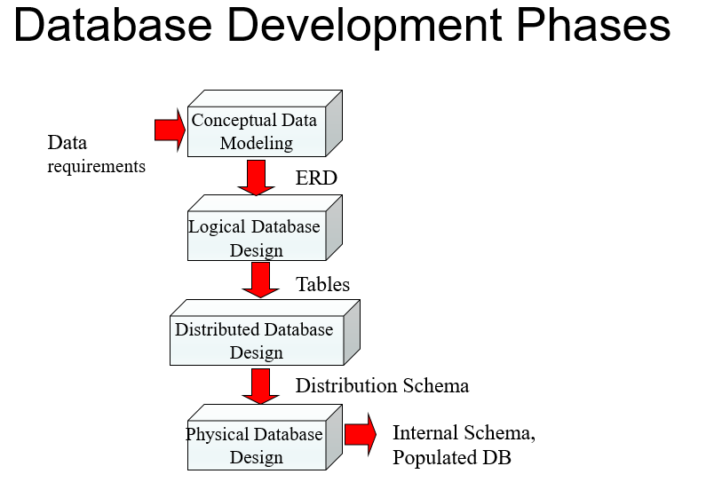

Slide 7
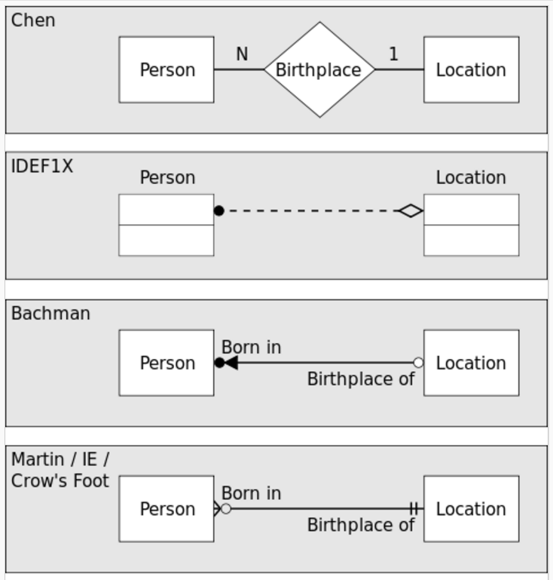
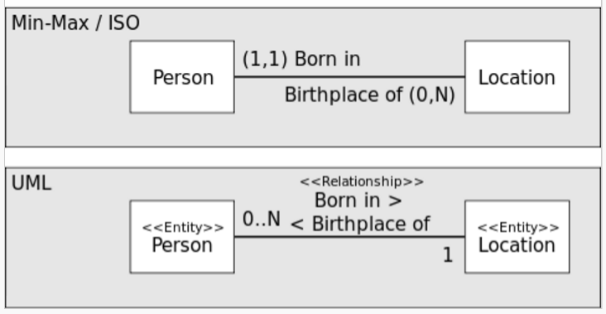
Popular Notations
Notes:
These are some popular notations.

Slide 8
ER model -- Database Modeling
The ER data model employs three basic concepts:
entity sets,
relationship sets,
attributes.
The ER model also has an associated diagrammatic representation, the ER diagram, which can express the overall logical structure of a database graphically.
Notes:
The ER data mode was developed to facilitate database design by allowing specification of an enterprise schema that represents the overall logical structure of a database.
The ER model is very useful in mapping the meanings and interactions of real-world enterprises onto a conceptual schema. Because of this usefulness, many database-design tools draw on concepts from the ER model.

Slide 9
Entity Sets
An entity is an object that exists and is distinguishable from other objects.
Example: specific person, company, event, plant
An entity set (entity type) is a set of entities of the same type that share the same properties.
Example: set of all persons, companies, trees, holidays
An entity is represented by a set of attributes.
Example:
instructor = (ID, name, street, city, salary ) course= (course_id, title, credits)
Notes:
The entity-relationship (E-R) data model was developed to facilitate database design by allowing specification of an enterprise schema that represents the overall logical structure of a database.
A subset of the attributes form a primary key of the entity set; i.e., uniquely identifying each member of the set.

Slide 10
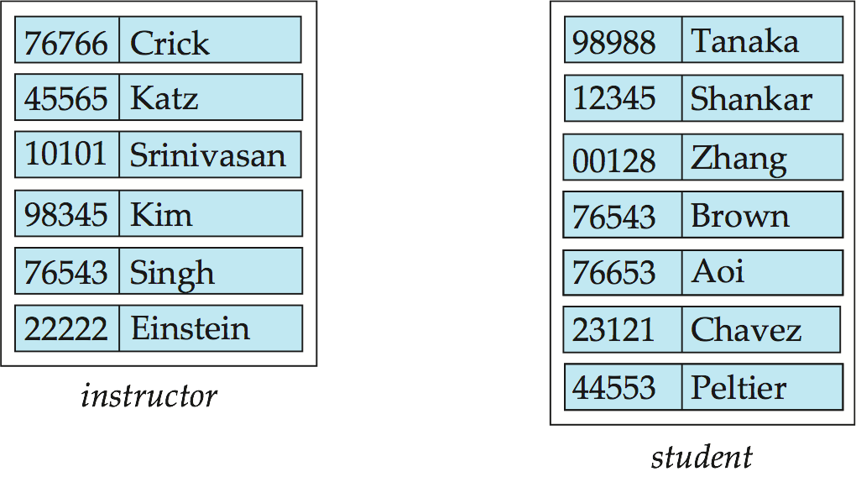
Entity Sets -- instructor and student
instructor_ID instructor_name student-ID student_name

Slide 11
Relationship Sets
A relationship is an association among several entities
Example: 44553 (Peltier) advisor 22222 (Einstein) student entity relationship set instructor entity
A relationship set is a mathematical relation among n ≥ 2 entities, each taken from entity sets, {(e₁, e₂, … e_{n}) | e₁ ∈ E₁, e₂ ∈ E₂, …, e_{n} ∈ E_{n}}, where (e₁, e₂, …, e_{n}) is a relationship
Example: (44553,22222) ∈ advisor
Notes:
A relationship is an association among several entities. For example, we can define a relationship advisor that associates instructor Katz with student Shankar. This relationship specifies that Katz is an advisor to student Shankar.
A relationship set is a set of relationships of the same type. Formally, it is a mathematical relation on n ≥ 2 (possibly nondistinct) entity sets.

Slide 12
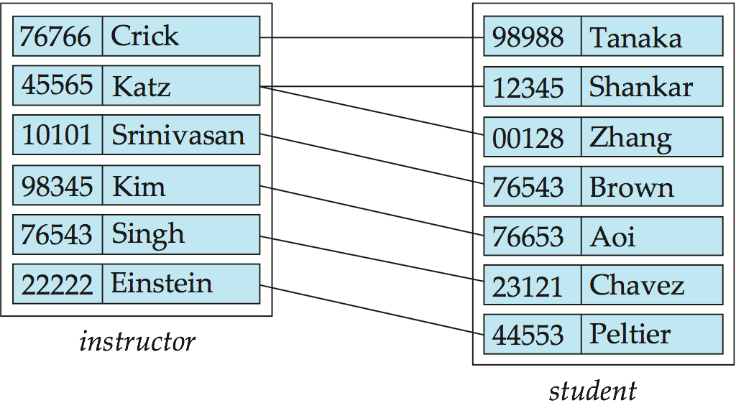
Relationship Set advisor
Notes:
The association between entity sets is referred to as participation; that is, the entity sets E1, E2, . . . , En participate in relationship set R. A relationship instance in an E-R schema represents an association between the named entities in the real-world enterprise that is being modeled. As an illustration, the individual instructor entity Katz,who has instructor ID 45565, and the student entity Shankar, who has student ID 12345, participate in a relationship instance of advisor. This relationship instance represents that in the university, the instructor Katz is advising student Shankar.

Slide 13
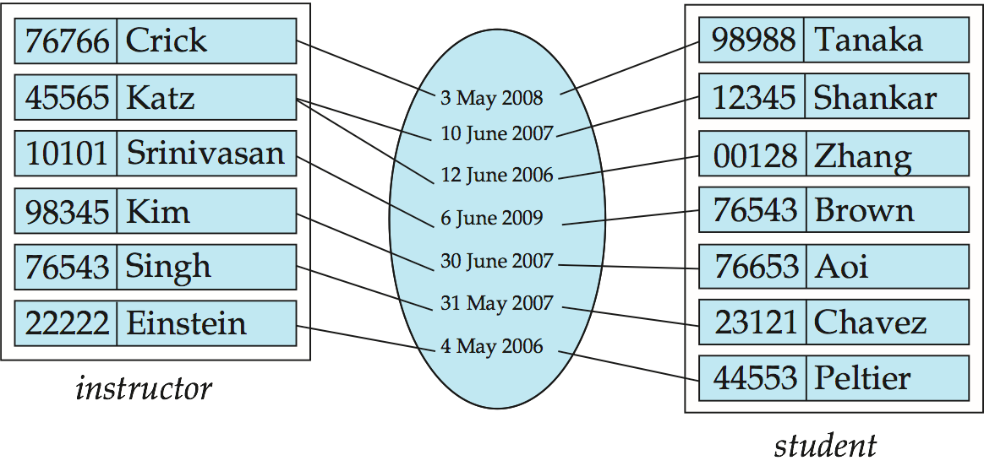
Relationship Sets (Cont.)
An attribute can also be associated with a relationship set.
For instance, the advisor relationship set between entity sets instructor and student may have the attribute date which tracks when the student started being associated with the advisor
Notes:
A relationship may also have attributes called descriptive attributes. Consider a relationship set advisor with entity sets instructor and student. We could associate the attribute date with that relationship to specify the date when an instructor became the advisor of a student. The advisor relationship among the entities corresponding to instructor Katz and student Shankar has the value “10 June 2007” for attribute date, which means that Katz became Shankar’s advisor on 10 June 2007.

Slide 14
Degree of a Relationship Set
binary relationship
involve two entity sets (or degree two).
most relationship sets in a database system are binary.
Relationships between more than two entity sets are rare. Most relationships are binary. (More on this later.)
Example: students work on research projects under the guidance of an instructor.
relationship proj_guide is a ternary relationship between instructor, student, and project.

Slide 15
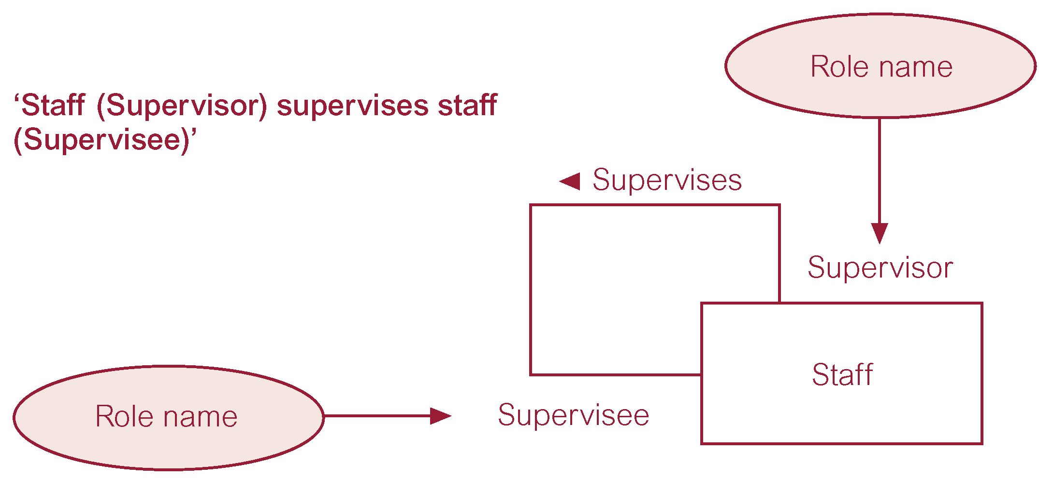
Recursive Relationship
Relationship type where same entity type participates more than once in different roles.

Slide 16
Mapping Cardinality Constraints
Express the number of entities to which another entity can be associated via a relationship set.
Most useful in describing binary relationship sets.
For a binary relationship set the mapping cardinality must be one of the following types:
One to one
One to many
Many to one
Many to many
Notes:
Mapping cardinalities, or cardinality ratios, express the number of entities to which another entity can be associated via a relationship set.
Constraints (rules, policies) -> Multiplicity= Cardinality (max) +Participation (min, altleast)

Slide 17
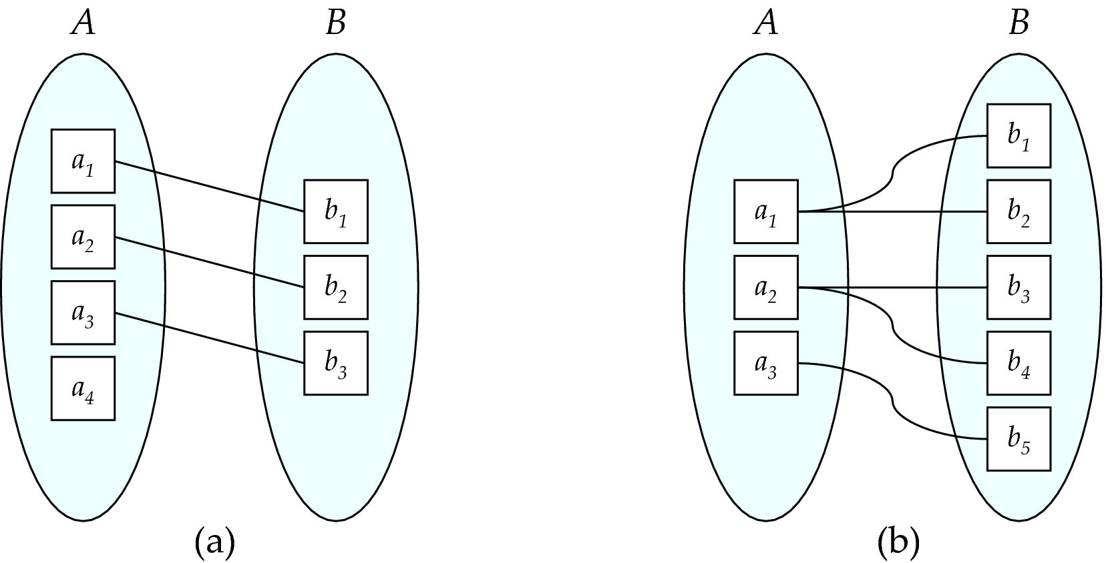
Mapping Cardinalities
One to one
One to many
Note: Some elements in A and B may not be mapped to any elements in the other set
Notes:
One-to-one. An entity in A is associated with at most one entity in B, and an entity in B is associated with at most one entity in A.
One-to-many. An entity in A is associated with any number (zero or more) of entities in B. An entity in B, however, can be associated with at most one entity in A.

Slide 18
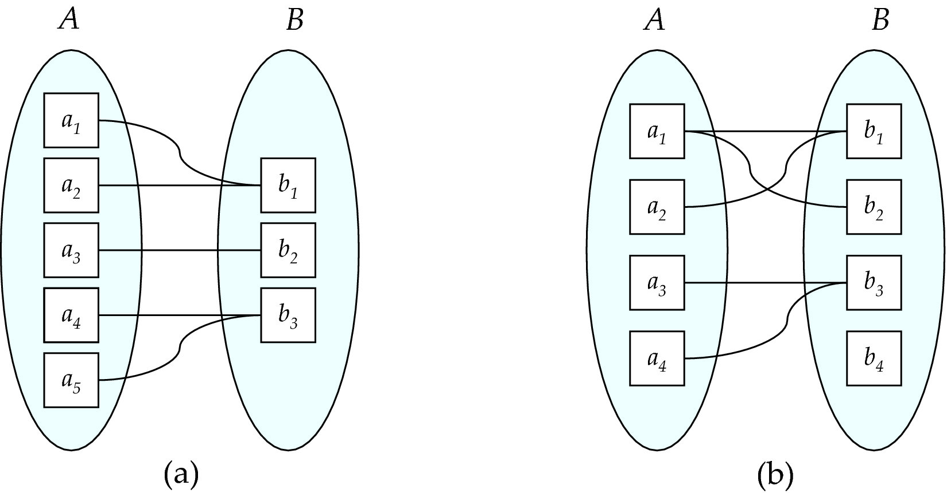
Mapping Cardinalities
Many to one
Many to many
Note: Some elements in A and B may not be mapped to any elements in the other set
Notes:
Many-to-one. An entity in A is associated with at most one entity in B. An entity in B, however, can be associated with any number (zero or more) of entities in A.
Many-to-many. An entity in A is associated with any number (zero or more) of entities in B, and an entity in B is associated with any number (zero or more) of entities in A.

Slide 19
Complex Attributes
Attribute types:
Simple and composite attributes.
Single-valued and multivalued attributes
Example: multivalued attribute: phone_numbers
Derived attributes
Can be computed from other attributes
Example: age, given date_of_birth
Domain – the set of permitted values for each attribute
Notes:
An attribute, as used in the E-R model, can be characterized by the following attribute types.
In our examples thus far, the attributes have been simple; that is, they have not been divided into subparts. Composite attributes, on the other hand, can be divided into subparts (that is, other
attributes). For example, an attribute name could be structured as a composite attribute consisting of first name, middle initial, and last name. Using composite attributes in a design schema is a good choice if a user will wish to refer to an entire attribute on some occasions, and to only a component of the attribute on other occasions.
The attributes in our examples all have a single value for a particular entity. For instance, the student ID attribute for a specific student entity refers to only one student ID. Such attributes are
said to be single valued. There may be instances where an attribute has a set of values for a specific entity. Suppose we add to the instructor entity set a phone number attribute. An instructor may have zero, one, or several phone numbers, and different instructors may have different numbers of phones. This type of attribute is said to be multivalued.

Slide 20
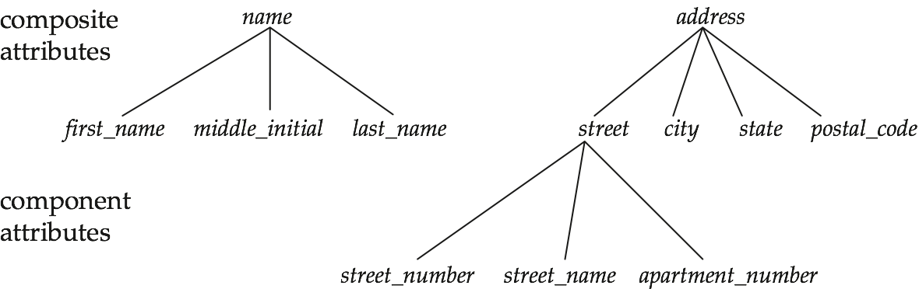
Composite Attributes

Slide 21
Redundant Attributes
Suppose we have entity sets:
instructor, with attributes: ID, name, dept_name, salary
department, with attributes: dept_name, building, budget
We model the fact that each instructor has an associated department using a relationship set inst_dept
The attribute dept_name appears in both entity sets. Since it is the primary key for the entity set department, it replicates information present in the relationship and is therefore redundant in the entity set instructor and needs to be removed.
BUT: when converting back to tables, in some cases the attribute gets reintroduced, as we will see later.

Slide 22
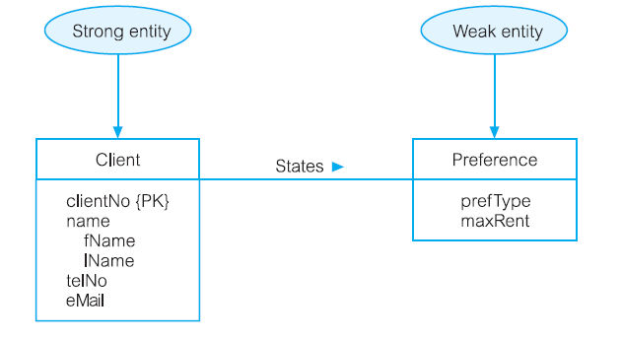
Weak Entity Sets
An entity set that does not have sufficient attributes to form a primary key is termed a weak entity set. An entity set that has a primary key is termed a strong entity set.
For a weak entity set to be meaningful, it must be associated with another entity set, called the identifying or owner entity set. The weak entity set is said to be existence dependent on the identifying entity set. The relationship associating the weak entity set with the identifying entity set is called the identifying relationship.
Notes:
We can uniquely identify each preference only through the relationship that a preference has with a client who is uniquely identifiable using the primary key for the Client entity type, namely clientNo. In this example, the Preference entity is described as having existence dependency for the Client entity, which is referred to as being the owner entity. Weak entity types are sometimes referred to as child, dependent, or subordinate entities and strong entity types as parent, owner, or dominant entities.

Slide 23
ER Diagrams

Slide 24
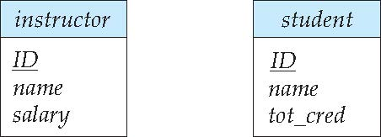
Entity Sets
Entities can be represented graphically as follows:
Rectangles represent entity sets.
Attributes listed inside entity rectangle
Underline indicates primary key attributes
Notes:
Entities set can be represented through Rectangle shape and attributes of that entity listed inside that rectangle.
The attributes associated with instructor are ID, name, and salary. The attributes associated with student are ID, name, and tot cred.
Attributes of an entity set that are members of the primary key are underlined.

Slide 25
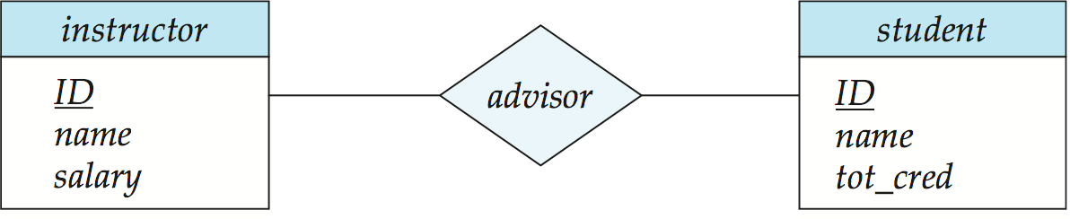
Relationship Sets
Diamonds represent relationship sets.
Notes:
Relationship set can be represented through diamond shape
this E-R diagram consists of two entity sets, instructor and student related through a binary relationship set advisor.

Slide 26
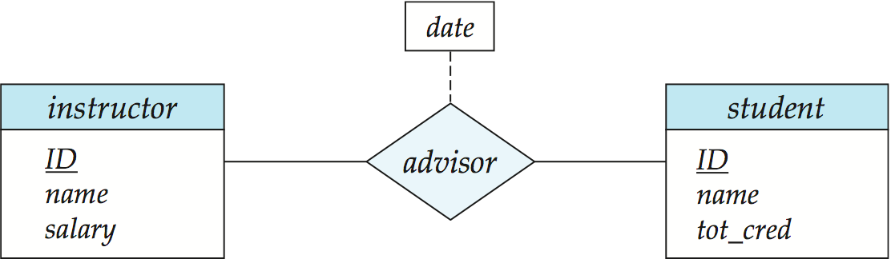
Relationship Sets with Attributes
Notes:
If a relationship set has some attributes associated with it, then we enclose the attributes in a rectangle and link the rectangle with a dashed line to the diamond representing that relationship set.

Slide 27
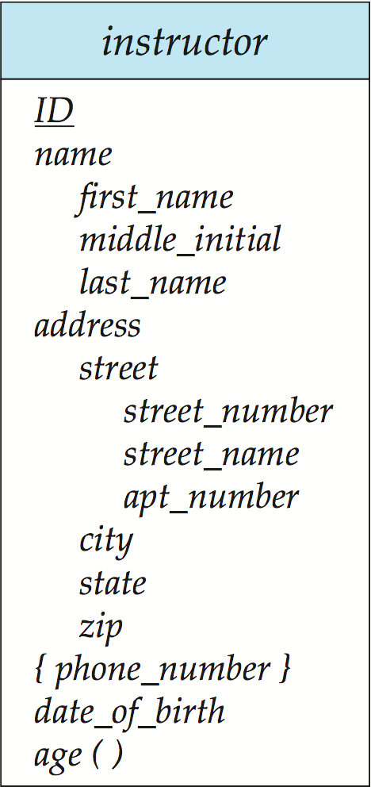
Notation to Express Entity with Complex Attributes

Slide 28
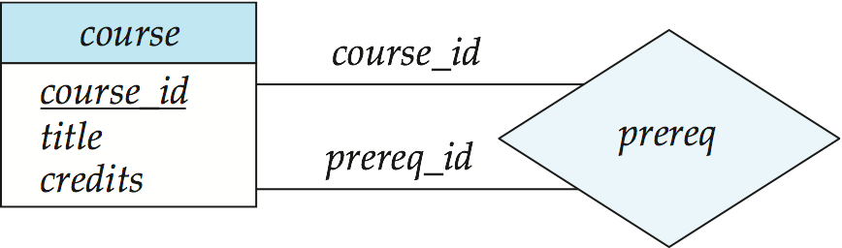
Roles
Entity sets of a relationship need not be distinct
Each occurrence of an entity set plays a “role” in the relationship
The labels “course_id” and “prereq_id” are called roles.

Slide 29
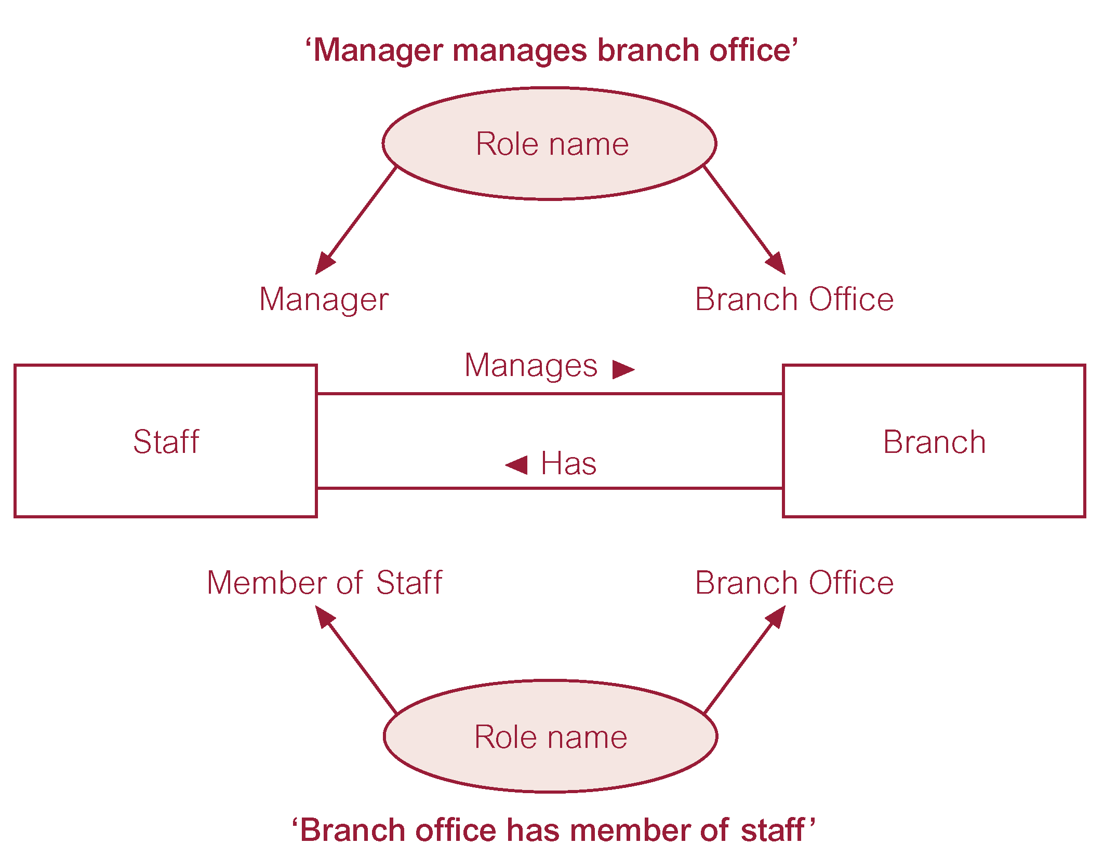
Entities associated through two distinct relationships with role names
Notes:
An example representing different role of staff.

Slide 30
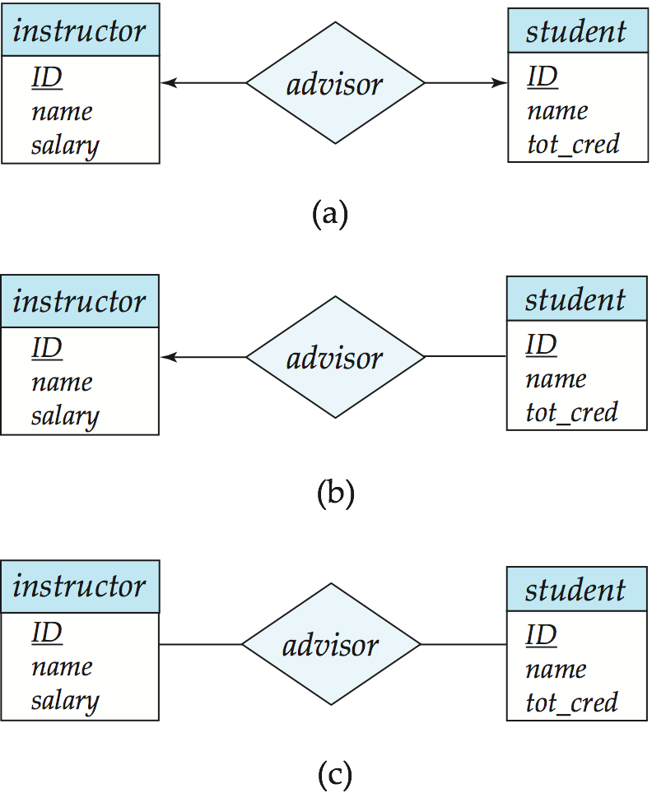
Cardinality Constraints
We express cardinality constraints by drawing either a directed line (→), signifying “one,” or an undirected line (—), signifying “many,” between the relationship set and the entity set.
One-to-one relationship between an instructor and a student :
A student is associated with at most one instructor via the relationship advisor
A student is associated with at most one department via stud_dept
Notes:
Cardinality of entities can be express using directed line and undirected line, Directed line represents one and undirected line represents many
Here we have one to one relationship between instructor and student that indicates that an instructor may advise at most one student, and a student may have at most one advisor.

Slide 31
One-to-Many Relationship
one-to-many relationship between an instructor and a student
an instructor is associated with several (including 0) students via advisor
a student is associated with at most one instructor via advisor,
Notes:
We draw a directed line from the relationship set advisor to the entity set instructor and an undirected line to the entity set student. This indicates that an instructor may advise many students, but
a student may have at most one advisor.

Slide 32
Many-to-One Relationships
In a many-to-one relationship between an instructor and a student,
an instructor is associated with at most one student via advisor,
and a student is associated with several (including 0) instructors via advisor
Notes:
Opposite of one to Many. We draw a undirected line from the relationship set advisor to the entity set instructor and an directed line to the entity set student. This indicates that an instructor can advise atmost one student, but a student may have many advisor.

Slide 33

Many-to-Many Relationship
An instructor is associated with several (possibly 0) students via advisor
A student is associated with several (possibly 0) instructors via advisor
Notes:
We draw an undirected line from the relationship set advisor to both entity sets instructor and student. This indicates that an instructor may advise many students, and a student may have many
advisors.

Slide 34
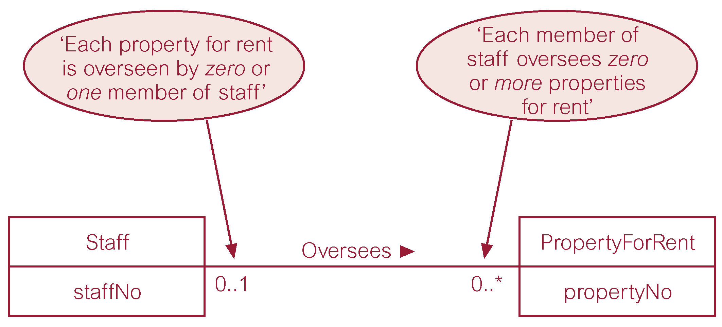
Notation for Expressing More Complex Constraints
A line may have an associated minimum and maximum cardinality, shown in the form l..h, where l is the minimum and h the maximum cardinality.
Notes:
We can express cardinality constraints graphically by l..h . Minimum cardinality also called participation.

Slide 35
Structural Constraints
Multiplicity is made up of two types of restrictions on relationships: cardinality and participation.
Cardinality
Describes maximum number of possible relationship occurrences for an entity participating in a given relationship type.
Participation
Determines whether all or only some entity occurrences participate in a relationship.
Notes:
a multiplicity is made up of a lower and an upper cardinality. A cardinality is how many elements are in a set. Thus, a multiplicity tells you the minimum and maximum allowed members of the set.
he simplest explanation would be to say: Multiplicity = Cardinality + Participation
Cardinality: Denotes the maximum number of possible relationship occurrences in which a certain entity can participate in (in simple terms: at most).
Participation: Denotes if all or only some entity occurrences participate in a relationship (in simple terms: at least).

Slide 36
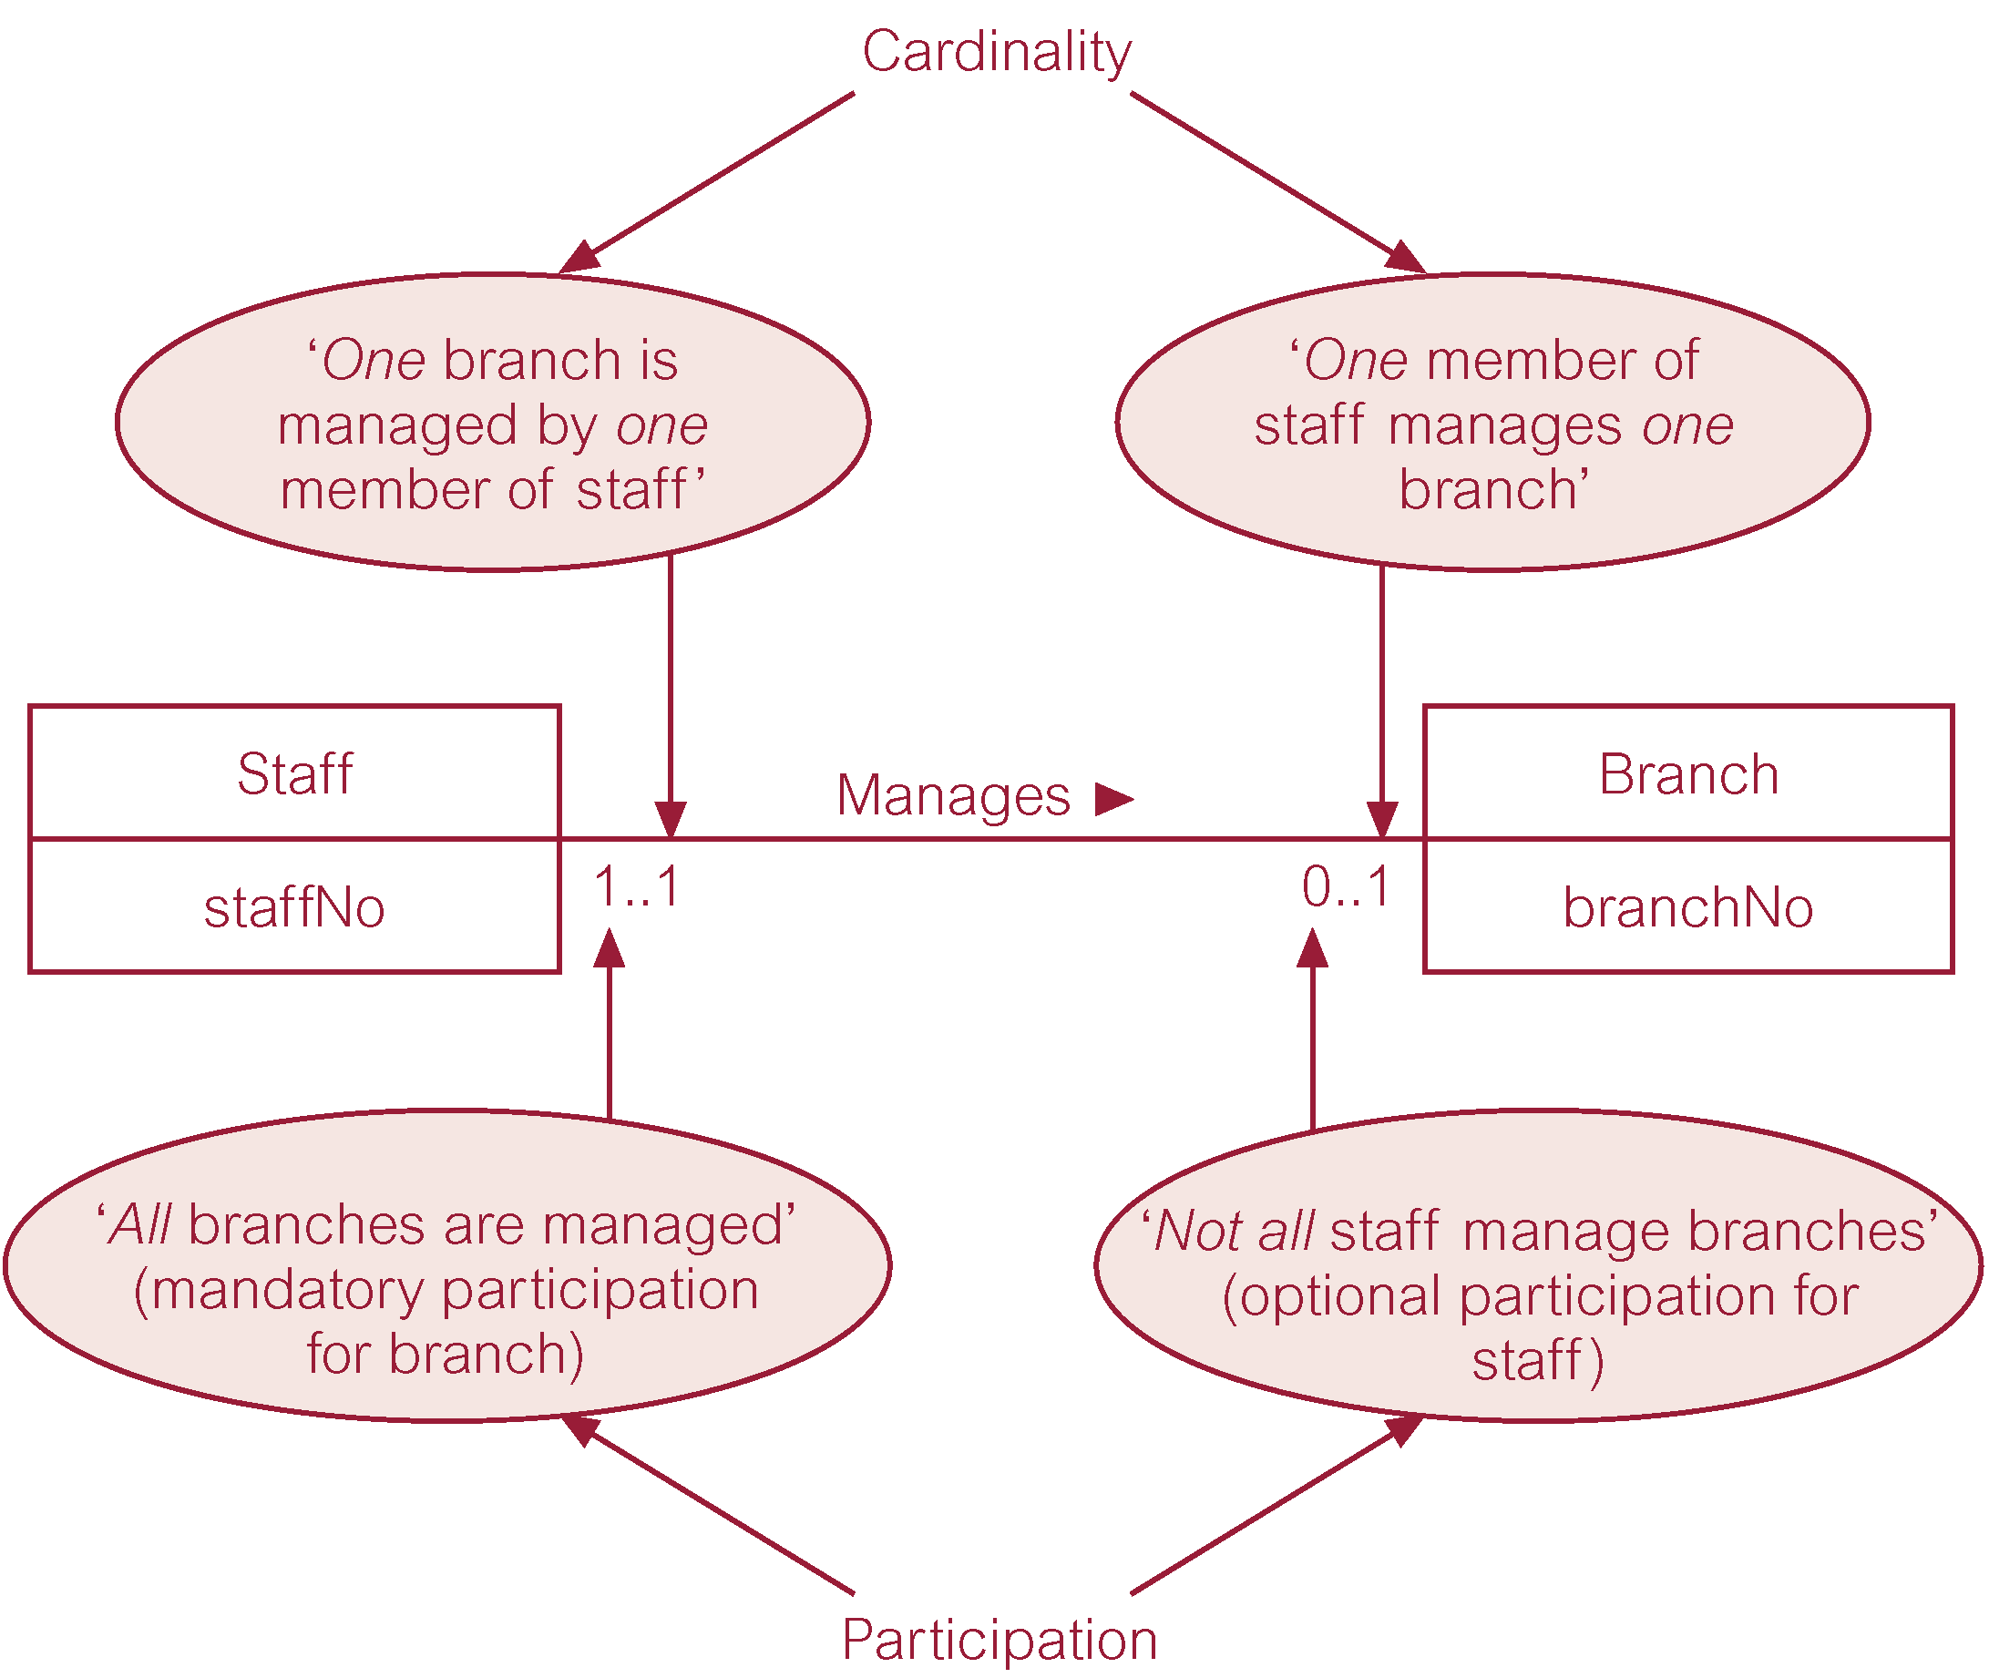
Multiplicity as cardinality and participation constraints
Notes:
Example of maximum and minimum cardinalities as multiplicity constraints.

Slide 37
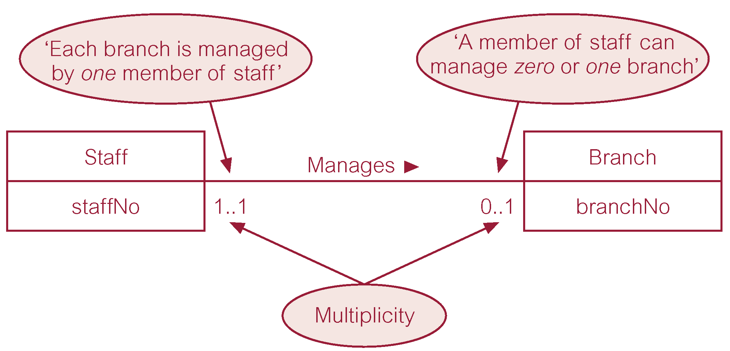
Multiplicity of Staff Manages Branch (1:1) relationship

Slide 38
Multiplicity of Staff Oversees PropertyForRent (1:*) relationship

Slide 39
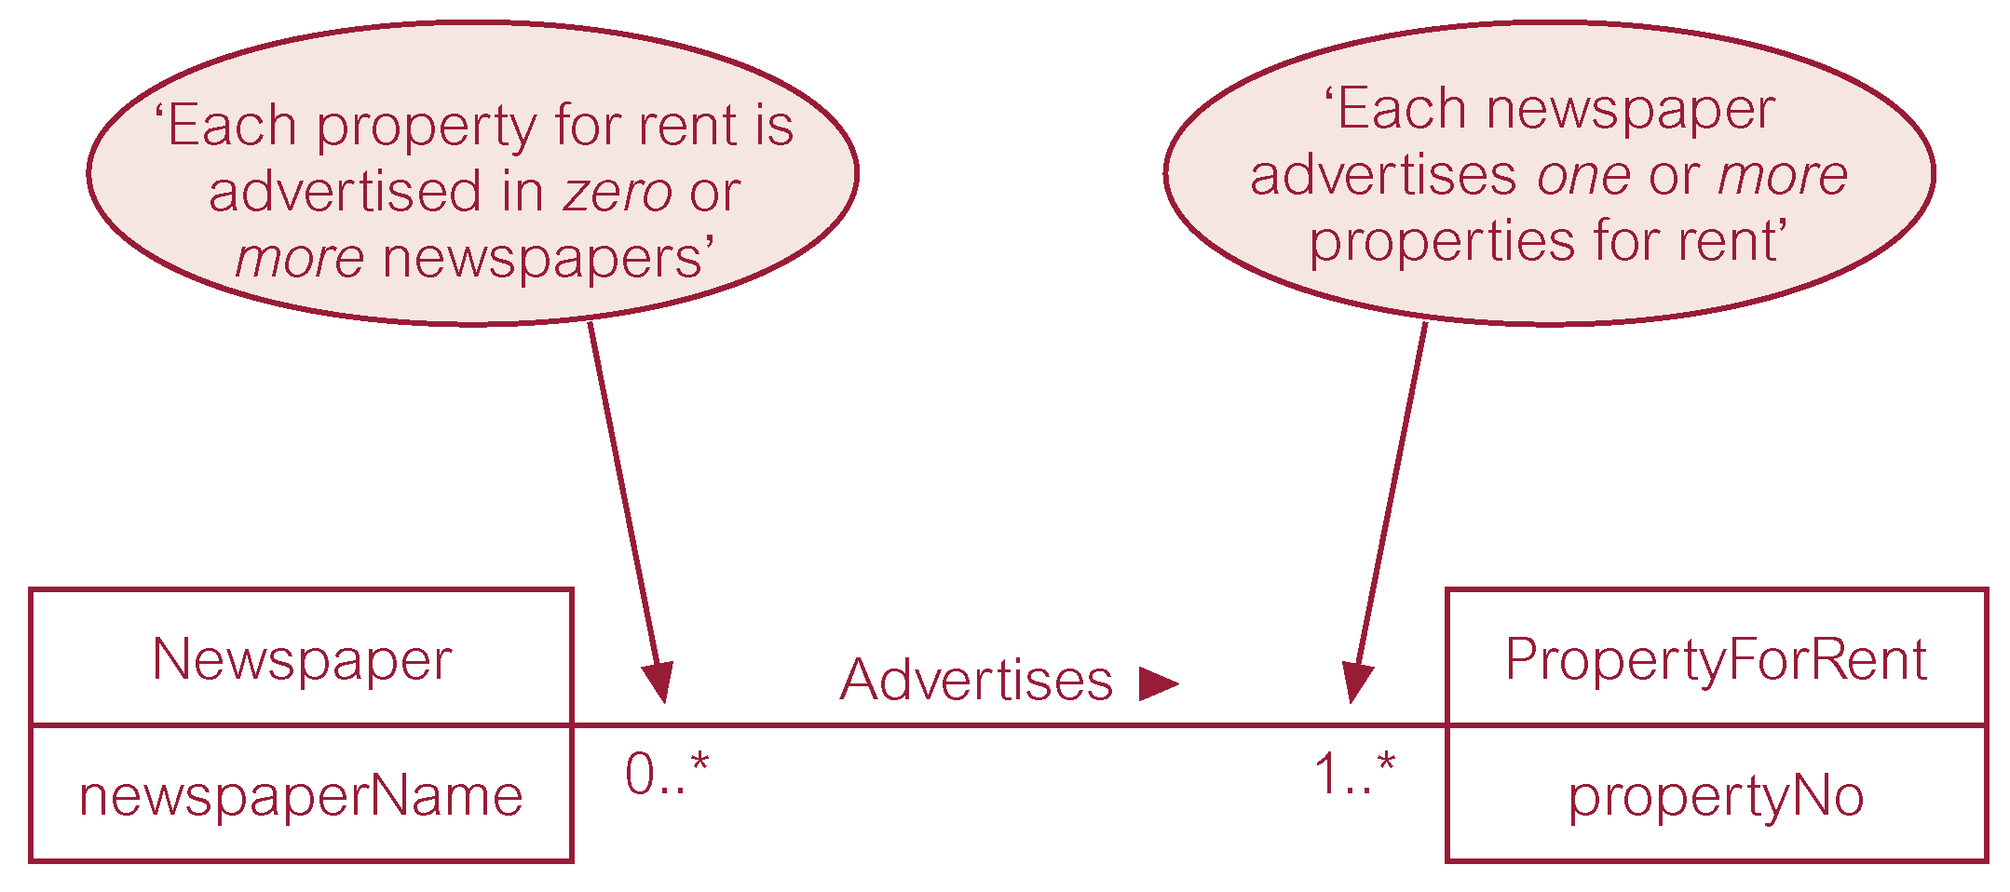
Multiplicity of Newspaper Advertises PropertyForRent (*:*) relationship

Slide 40
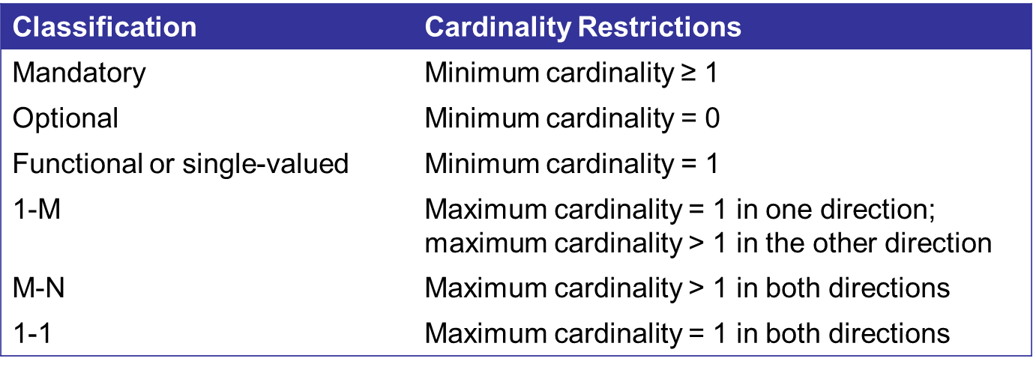
Important cardinalities

Slide 41
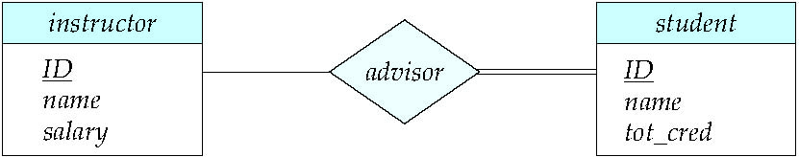
Total and Partial Participation
Total participation (indicated by double line): every entity in the entity set participates in at least one relationship in the relationship set
participation of student in advisor relation is total
every student must have an associated instructor
Partial participation: some entities may not participate in any relationship in the relationship set
Example: participation of instructor in advisor is partial
Notes:
Some instructor are not advisor of any students, so we have some entities that are not participating in the relationship set so we say their participation is partial. And if all entities of an entity set participate in a relationship then it called total participation.

Slide 42
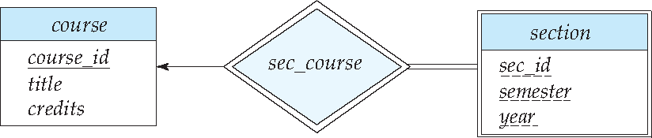
Expressing Weak Entity Sets
In E-R diagrams, a weak entity set is depicted via a double rectangle.
We underline the discriminator of a weak entity set with a dashed line.
The relationship set connecting the weak entity set to the identifying strong entity set is depicted by a double diamond.
Primary key for section – (course_id, sec_id, semester, year)

Slide 43
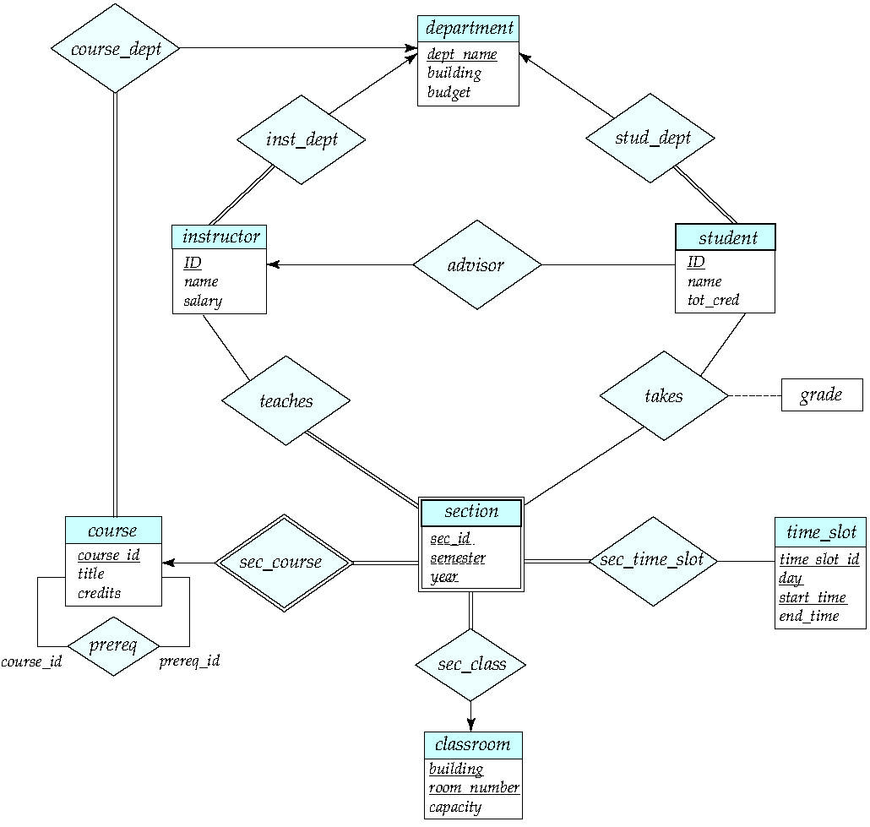
E-R Diagram for a University Enterprise

Slide 44
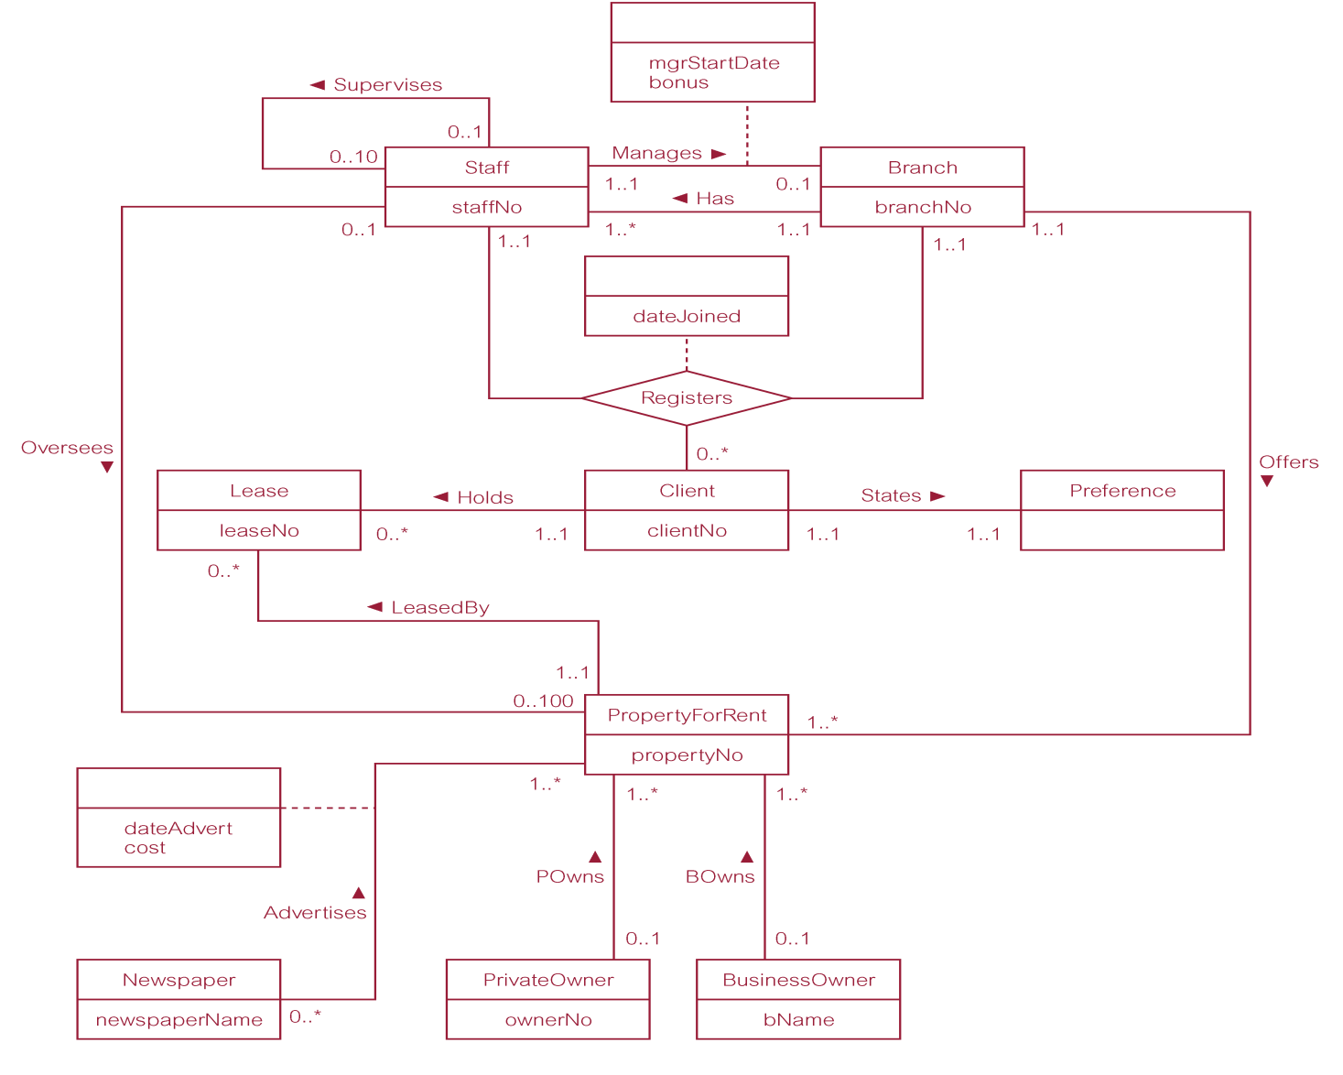
ER diagram of Branch user views of DreamHome

Slide 45
Practice Question 01
Draw an ERD containing Student and Paper entity types connected by a 1-M relationship. The Student entity type should have attributes for StdNo (primary key), StdFirstName, StdLastName, StdAdmitSemester, StdAdmitYear, and StdEnrollStatus (full or part-time). The Paper entity type should have attributes for PaperNo (primary key), PaperTitle, PaperSubmitDate, PaperAccepted (yes or no), and PaperType (first, second, proposal, or dissertation). Add a 1-M relationship from Student to Paper.

Slide 46
Practice Question 02
A manufacturing company produces products.
The following product information is stored: product name, product ID and quantity on hand.
These products are made up of many components. Each component can be supplied by one or more suppliers. The following component information is kept: component ID, name, description, suppliers who supply them, and products in which they are used.
Create an ERD to show how you would track this information.
Show entity names, primary keys, attributes for each entity, relationships between the entities and cardinality.
ASSUMPTIONS
A supplier can exist without providing components.
A component does not have to be associated with a product. Not all components are used in products.
A product cannot exist without components.

Slide 47
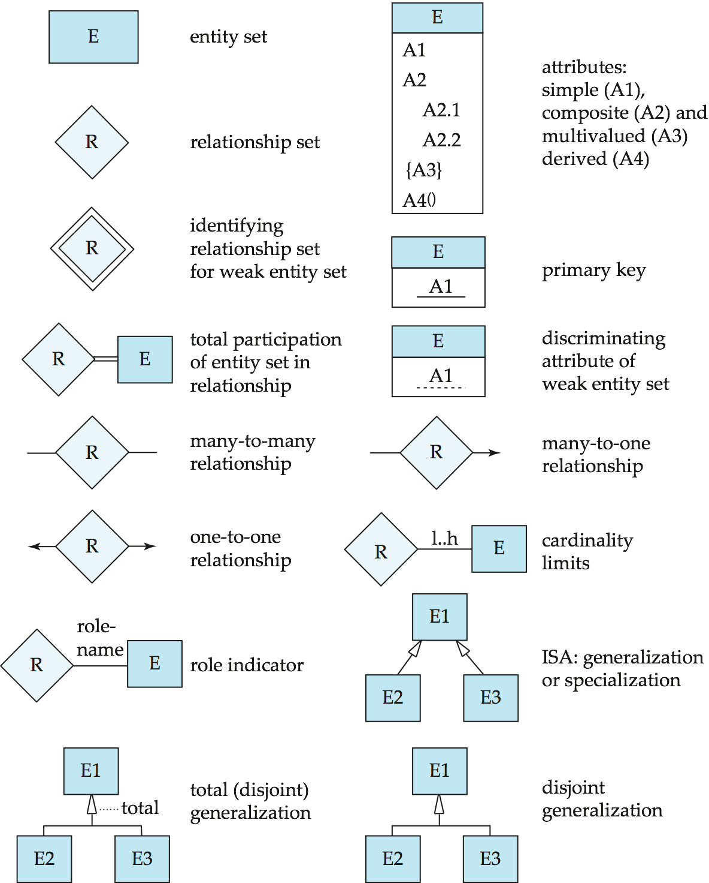
Summary of Symbols Used in E-R Notation

Slide 48
Symbols Used in E-R Notation (Cont.)

Slide 49
Suggested Reading
Chapter 12 of Database Systems: A Practical Approach to Design, Implementation, and Management by Thomas Conolly 6th Edition
Chapter 7 of Database System Concepts by Abraham Silberschatz

